Slide 1
Complete system response- Transient and steady state response
Natural and force responses in first and second order systems

Slide 2
Natural and force responses in first and second order systems

Slide 3
First and second order circuits
RL Circuit
RC Circuit
RLC Circuit
First-order differential equation
Second-order differential equation
Order of a circuit depends on the number of energy storage elements

Slide 4
Switch
Close at t =0
Open at t =0
t < 0
3-way switch

Slide 5
Switch
Close at t =0
Open at t =0
t > 0
3-way switch

Slide 6
v(t)
v(t)
1V
1V
0V
0V
t
t
Step function (unit)

Slide 7
I = 1A
I = 2A
Voltage source change from 1V to 2V immediately
Does the current change immediately too?

Slide 8
Voltage
AC voltage
2V
1V
time
Current
2A
1A
time

Slide 9
I = 1A
I = 2A
Voltage source change from 1V to 2V immediately
Does the current change immediately too?

Slide 10
Voltage
AC voltage
2V
1V
time
Current
2A
1A
Forced Response
time
Transient Response + Forced Response

Slide 11
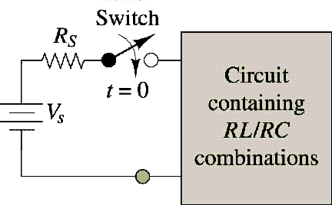
A general model of electrical circuit
Total response = Natural response + Force response
= Transient response + steady state response
= Response up to 5 time constant(τ) + Response after 5 time constant(τ)
i (t) = i TR (t) + iSS (t)
= k e^{-t/τ} + iSS (t)
In other words, for a first or second order electrical or mechanical system when modelled
As differential equation
Complete solution = Homogenous solution + particular solution

Slide 12
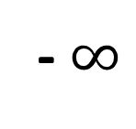
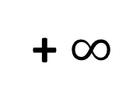
Time line representation and why transient in a circuit?
- $∞$
0⁻
0
0⁺
5τ
+ $∞$
Why there is a transient response?
The voltage across a capacitor cannot be changed instantaneously.
The current across an inductor cannot be changed instantaneously.

Slide 13

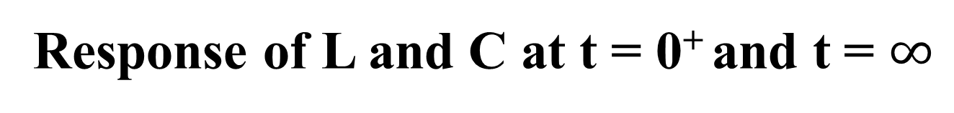
Response of L and C at t = 0⁺ and t = $∞$
We know
Z_{L} = jX_{L} = jωL
Z_{C} = 1/ jX_{C} = 1\jωC
At t = 0⁺ i.e. transient state
At t = $∞$ i.e. steady state
L Open circuit
C Short circuit
L Short circuit
C Open circuit

Slide 14
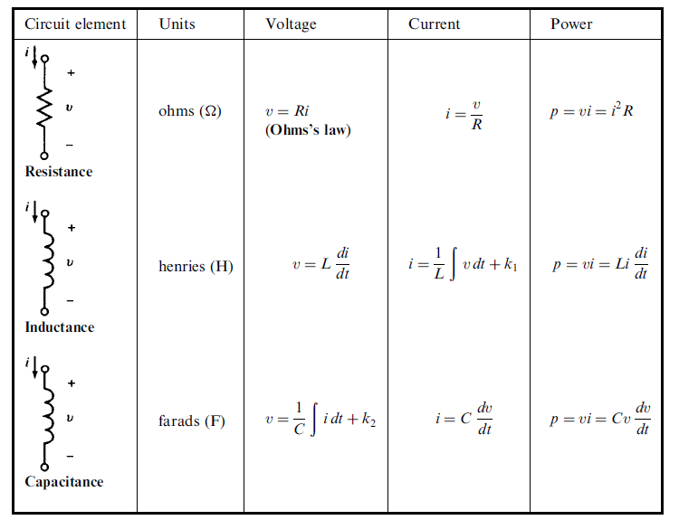
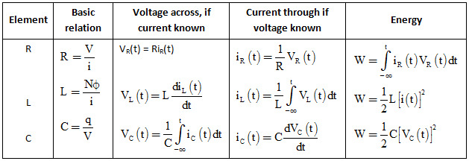

Slide 15
PART -2
Types of transient
- DC transient
- AC transient (AC circuit analysis and phasors)

Slide 16
DC TRANSIENT ANALYSIS

Slide 17
R
R
i
i
V_{s}
L
v_{s}
–
+
C
–
+
An RL circuit
An RC circuit

Slide 18
Natural response
The natural response of an RL and RC circuit is its behavior (i.e., current and voltage ) when stored energy in the inductor or capacitor is released to the resistive part of the network (containing no independent sources) – SOURCE FREE CIRCUITS
Step response
The steps response of RL and RC circuits is its behavior when a voltage or current source step is applied to the circuit, or immediately after a switch state is changed.

Slide 19
NATURAL RESPONSE OF AN RL CIRCUIT
Consider the following circuit, for which the switch is closed for t<0, and then opened at t = 0:
The dc has been supplying the RL circuit with constant current for a long time
t = 0
i
+
V
–
I_{s}
R_{o}
L
R

Slide 20
Solving for the circuit
For t ≤ 0, i(t) = Io
For t ≥ 0, the circuit reduce to
Notation:
is used to denote the time just prior to switching.
is used to denote the time immediately after switching.
i
+
v
–
I_{o}
R_{o}
L
R

Slide 21
Continue…
Applying KVL to the circuit:
(1)
(2)
(3)
(4)

Slide 22
Continue
From equation (4), let say;
Integrate both sides of equation (5);
Where:
i(to) is the current corresponding to time to
i(t) ia the current corresponding to time t
(5)
(6)

Slide 23
Continue
Therefore,
hence, the current is
(7)

Slide 24
Continue
From the Ohm’s law, the voltage across the resistor R is:
And the power dissipated in the resistor is:

Slide 25
Continue
Energy absorb by the resistor is:

Slide 26
Time Constant, τ
Time constant, τ determines the rate at which the current or voltage approaches zero.
Time constant, (sec)

Slide 27

The expressions for current, voltage, power and energy using time constant concept:

Slide 28
i(t)
I₀
Natural Response
of RL circuit
Approach zero
t
Natural Response only

Slide 29
Switching time
For all transient cases, the following instants of switching times are considered.
t = 0⁻ , this is the time of switching between -∞ to 0 or time before.
t = 0⁺ , this is the time of switching at the instant just after time t = 0s (taken as initial value)
t = ∞ , this is the time of switching between t = 0⁺ to ∞ (taken as final value for step response)

Slide 30
The illustration of the different instance of switching times is:
-∞
∞

Slide 31
Example
For the circuit below, find the expression of io(t) and Vo(t). The switch was closed for a long time, and at t = 0, the switch was opened.
2Ω
i0
t = 0
+
V
–
_{0.1Ω}
2H
_{10Ω}
20A
40Ω
iL

Slide 32
Solution :
Step 1:
Find τ for t > 0. Draw the equivalent circuit. The
switch is opened.
So;
sec

Slide 33
Step 2:
At t = 0⁻ , time from -∞ to 0^{-,} the switch was closed for
a long time.
The inductor behave like a short circuit as it being
supplied for a long time by a dc current source. Current
20A thus flows through the short circuit until the switch
is opened.
Therefore; i_{L}(0⁻) = 20A
2Ω
20A
_{0.1Ω}
_{10Ω}
40Ω
iL(0-)

Slide 34
Step 3:
At the instant when the switch is opened, the time t = 0⁺,
The current through the inductor remains the same (continuous).
Thus, which is the initial current.
Only at this particular instant the value of the current through the
inductor is the same.
Since, there is no other supply in the circuit after the switch is
opened, this is the natural response case.
2Ω
i_{o}(0⁺)
+
v_{o}(0⁺)
–
20A
2H
_{10Ω}
40Ω
i_{L}(0⁺)

Slide 35
By using current division, the current in the 40Ω resistor
is:
So,
Using Ohm’s Law, the V_{o} is:
So,

Slide 36
NATURAL RESPONSE OF AN RC CIRCUIT
Consider the following circuit, for which the switch is closed for t < 0, and then opened at t = 0:
Notation:
0⁻ is used to denote the time just prior to switching
0⁺ is used to denote the time immediately after switching.
R_{o}
t = 0
+
−
+
v
–
V_{o}
R
C

Slide 37
Solving for the voltage (t ≥ 0)
For t ≤ 0, v(t) = V_{o}
For t > 0, the circuit reduces to
i
R_{o}
+
v
–
V_{o}
+
−
C
R

Slide 38
Continue
Applying KCL to the RC circuit:
(1)
(2)
(3)
(4)
(5)

Slide 39
Continue
From equation (5), let say:
Integrate both sides of equation (6):
Therefore:
(6)
(7)
(8)

Slide 40
Continue
Hence, the voltage is:
Using Ohm’s law, the current is:

Slide 41
Continue
The power dissipated in the resistor is:
The energy absorb by the resistor is:

Slide 42
Continue
The time constant for the RC circuit equal the product of the resistance and capacitance,
Time constant, sec

Slide 43
The expressions for voltage, current, power and energy using time constant concept:

Slide 44
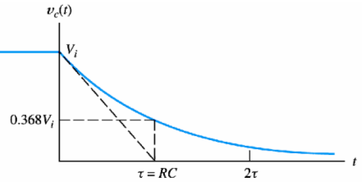
Exponential decay waveform RC is called the time constant.
At time constant, the voltage is 36.8% of the initial voltage.

Slide 45
For the case of capacitor, two important observation can be made,
1) capacitor behaves like an open circuit when being supplied by dc source
(From, i_{c} = Cdv/dt, when v is constant, dv/dt = 0. When current in circuit is zero, the circuit is open circuit.)
2) in capacitor, the voltage is continuous / stays the same that is, V_{c}(0⁺) = V_{c}(0⁻)

Slide 46
Example
The switch has been in position a for a long time. At
Time t = 0, the switch moves to b. Find the expressions
for the v_{c}(t), i_{c}(t) and v_{o}(t) and hence sketch them for t =
0 to t = 5τ.
5kΩ
a
b
18kΩ
t = 0
+
V_{o}
–
90V
+
−
10kΩ
60kΩ
12kΩ
0.1μF

Slide 47
Solution
Step 1:
Find t for t > 5τ that is when the switch was at a. Draw
the equivalent circuit.
18kΩ
0.1μF
60kΩ
12kΩ

Slide 48
Step 2:
At t = 0, the switch was at a. the capacitor behaves like
An open circuit as it is being supplied by a constant
source.
5kΩ
+
V_{c}(0⁻)
–
90V
+
−
10kΩ

Slide 49
Step 3:
At t = 0⁺, the instant when the switch is at b.
The voltage across capacitor remains the same at this
particular instant.
v_{c}(0⁺) = v_{c}(0⁻) = 60V
18kΩ
+
60V
–
+
V_{o}
–
0.1μF
60kΩ
12kΩ

Slide 50
Using voltage divider rule,
Hence;

Slide 51
Summary
No | RL circuit | RC circuit
1
2 | Inductor behaves like a short circuit when being supplied by dc source for a long time | Capacitor behaves like an open circuit when being supplied by dc source for a long time
3 | Inductor current is continuous i_{L}(0⁺) = i_{L}(0⁻) | Voltage across capacitor is continuous v_{C}(0⁺) = v_{C}(0⁻)

